Slide 1

2026 Cohort Welcome meeting

Slide 2
How will learning look at Buckden school?
Continuation of what have been doing in preschool and nursery settings. Working on Development Matters then 17 ELG’s which are reported on at end of year as emerging, expected. 3 prime areas PSED, C&L, PD, 4 specific Literacy, Maths, Ex Arts and Design and Understanding World. Will still be play based.
Baseline assessment- Government baseline will be completed in first weeks along with own baseline through conversations with parents, settings and our observations.
Observations and playing with children and asking questions, getting to know them individually.
Class unit structure- 2 classes separate for the mornings but join for the afternoons. May be swaps until balance/ needs are best met.
‘Little Wandle’ phonics begins from Week 2. A parents’ session specifically on this will take place in September. New this cohort.

Slide 3
How will learning look at Buckden school?
Importance of reading- short, daily home reading makes so much difference to a child’s success and enjoyment of reading. We use the app Boom Reader. Log in information will be sent home with your child in the second week.
Home/School agreement- daily reading with your child is mandatory not optional as it directly impacts their future success in all learning areas.
Later in the year, some online maths homework- Doodle maths.
Funky finger activities, dough disco and circuits to strengthen muscles needed for writing. Move onto pencil control and patterns then letter formation.
Maths-Follow NCETM mastering number and White Rose which focuses upon developing a firm foundation of numbers 0-10 including subtising, composition, comparison and pattern in number. A parent meeting will be scheduled to share more about this in October.
Topic based half termly themes linked to global learning goals and including history, geography, science, art, DT, PSHE music, French and RE. Half termly newsletter sent with info.

Slide 4
How will learning look at Buckden school?
Mind Up Mental Health Brain Breaks
French
Nature schools, local visits and having visitors in.
Skills builder projects- listening, leadership, creativity, presenting
problem solving, team work, aiming high, staying positive.
Oracy- Three minute talk. Your child will be given a day to bring in something linked to our topic to share and discuss. The timetable will be sent in the first week of each half term. First presentation will be based upon ‘All about me bag’.

Slide 5
Working together
Encouraging independence in your child- adult/ child ratios are significantly higher than preschool and nursery settings. Self help skills and problem solving and tolerating delay are so important.
We are proud to be an inclusive school. We teach children to accept and understand children with additional needs and ask that you do the same.
Parents’ evenings- October, February
Progress and learning behaviour reports
End of year report based upon Early Learning Goals and Characteristics of Effective Learning and skills builder
Email via- kwoodward@bpa.act-academytrust.org or dheal@bpa.act-academytrust.org and we will respond as soon as possible.
Attendance- really important as learning in Reception happens at a fast pace and social impact of missed days. Fines given for term time holidays set by Government policy.

Slide 6
Learning themes
Linked to the whole school Global Learning Curriculum
Autumn 1- Magical Me- Good Health and Wellbeing and Quality Education
Autumn 2- Celebrations- Reduced Inequalities
Spring 1- Once Upon a Time- No Poverty
Spring 2- Super Heroes- Peace and Justice
Summer 1- Down at the Bottom of the Garden- Life on Land, Climate Action, Responsible Consumption
Summer 2- Around the World in ?? Days- Sustainable Cities and Communities
Notes:
Give examples. Remain calm and positive. It will happen. Getting the environment right. Keep it fun.

Slide 7
Transition Plan- (
We have already been visiting your children in their settings or will be having conversations with their key people over the phone when this has not been possible.
Short visits into our school in the mornings of first week in July to get to know the space and one another.
Home visits for first time families in first week in July, telephone conversations with second time families.
Smaller group start during first week back to allow children to get used to the whole day routines, have a lunch and for us to administer the Government Baseline Assessment effectively.

Slide 8
Importance of regular reading
Key Findings from research around early childhood reading.
The frequency of reading to children at a young age has a direct causal effect on their schooling outcomes.
Reading to children at age 4-5 every day has a significant positive effect on their reading skills and cognitive skills (i.e., language and literacy, numeracy and cognition) later in life.
Reading to children 3-5 days per week (compared to 2 or less) has the same effect on the child’s reading skills at age 4-5 as being six months older.
Reading to them 6-7 days per week has the same effect as being almost 12 months older.
Children read to more frequently at age 4-5 achieve higher scores in national assessments
These differences in reading and cognitive skills are not related to the child’s family background or home environment but are the direct result of how frequently they have been read with.
Notes:
Whilst we do teach reading every day through phonics lessons with your children and hear your child read at least once a week, what we cannot do is offer the 1:1 daily reading needed for overlearning and embedding of reading skills over time.

Slide 9
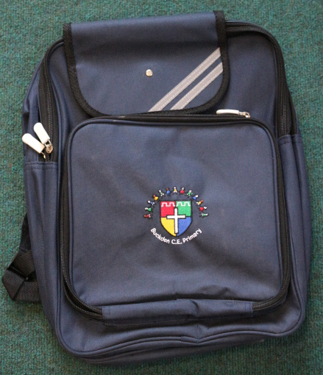

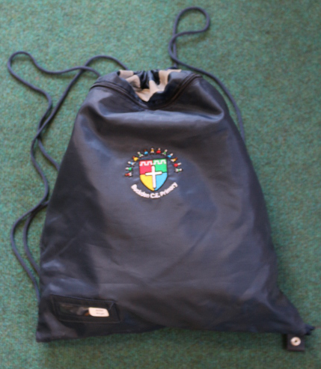




What your child will Need
Name on everything!

Slide 10
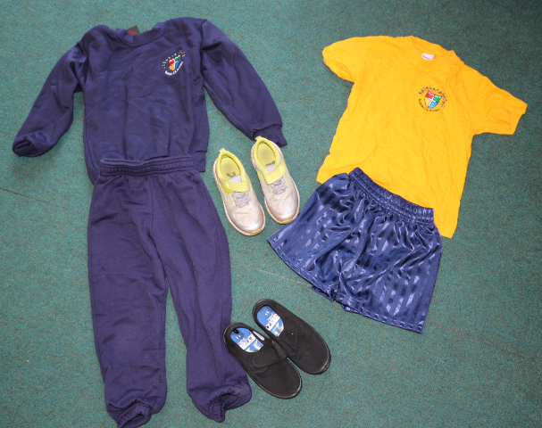
PE Kit
Indoor
Outdoor
Blue shorts
House t-shirt
Socks
Blue trousers
Blue jumper
House t-shirt
Trainers
Socks
Girls hair must be tied back at all times using navy blue or white simple hair ties. Earrings must be covered.

Slide 11
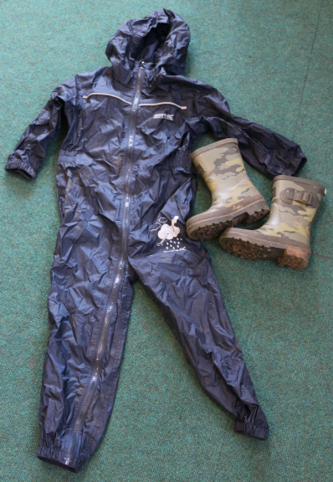
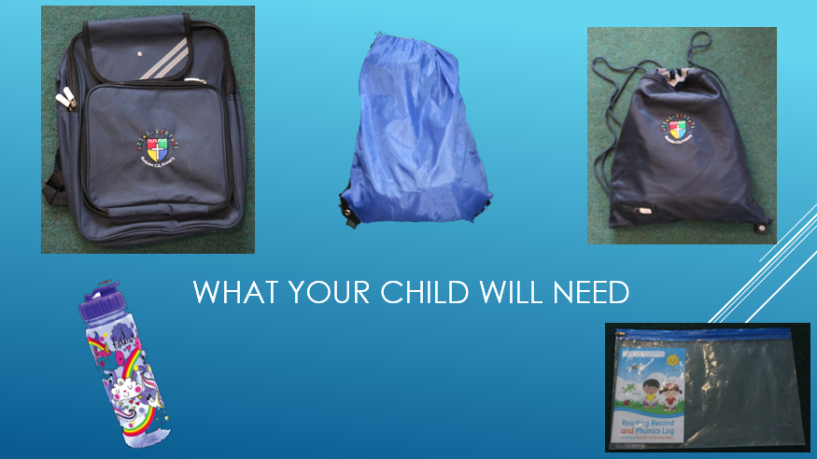
Wellie Bag
Wellies
Puddle suit

Slide 12

School Bag
Water Bottles- no juice, just water
Sunhat
Reading Folder

Slide 13
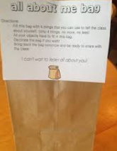
All about me bag
We will hand these out when your child comes for their transition visit during first week in July.
Fill with items that show your child’s interests, family, pets. Can be things, pictures or photos.
These are shared with whole class to see who shares interests and help establish friendships and are used
for your child to have a look at whenever they wish to. Nothing too precious as things will be looked at/
touched by others.

Slide 14
Other Things
School dinners- choices- each day meat, vegetarian, jacket potato/ fish, cheese sandwich, ham sandwich, vegetable fajita, chicken wrap. You can make choice on Arbor for child. May not work for first day in September.
Morning snack- fruit/ veg provided but can bring in own fruit or veg also. No other snacks allowed.
Whatsapp groups/ facebook groups. These are great to help organise get togethers over the summer or send reminders about events or things to bring in. Any other queries, questions or problems please contact teachers email so we can respond directly, fully and promptly.
Parent volunteering- come in and hear readers, help with church walks, locality walks and excursions. People who help us visitors.
All about me bags- bring in in September please

Slide 15
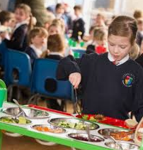

School dinners
Dietary needs can be catered for- Mrs Stewart will happily discuss this with families. dstewart@bpa.act-academytrust.org

Slide 16
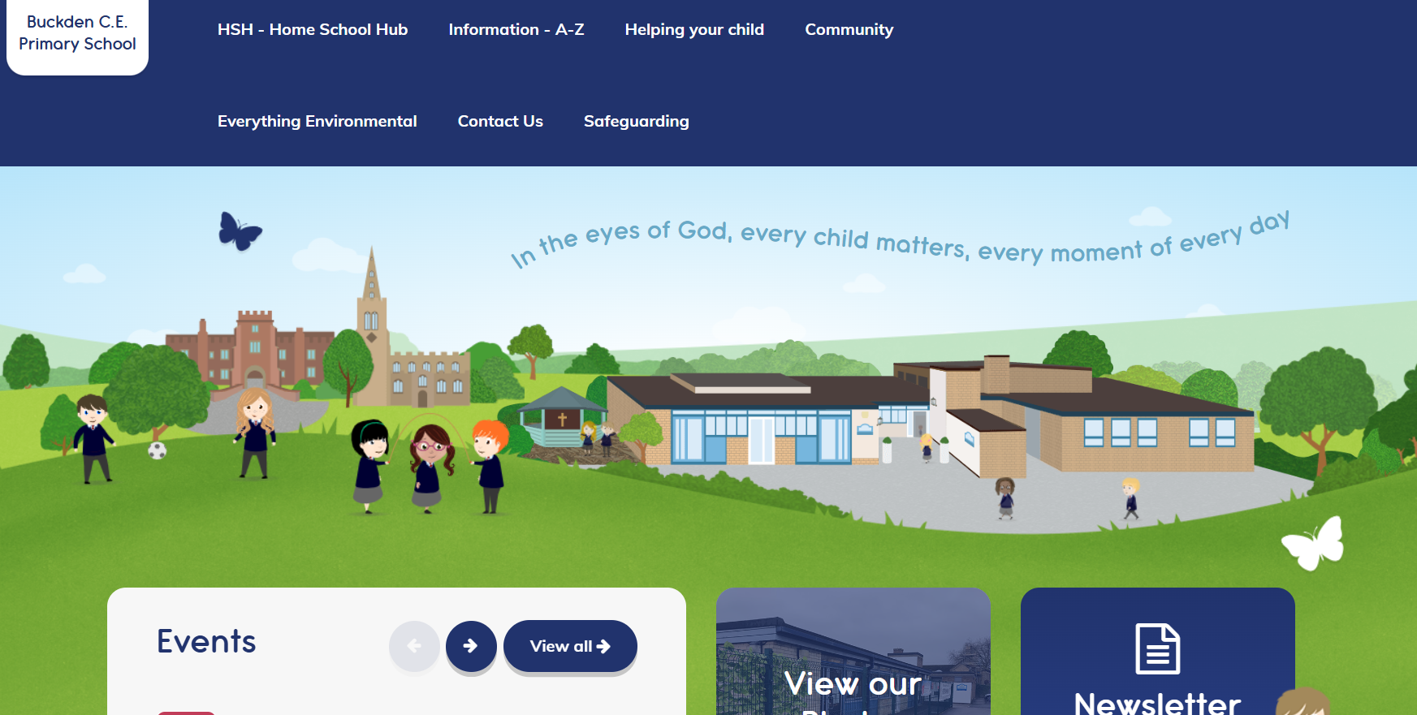
School Website
https://www.buckdenschool.co.u
https://www.buckdenschool.co.uk/
Helping your child. Policies. Calendar. Events. Weekly blog. Dinner menus.

Slide 17

chrome-extension://efaidnbmnnnibpcajpcglclefindmkaj/https://startingreception.co.uk/wp-content/uploads/2025/03/Starting-Reception.pdf

Slide 18
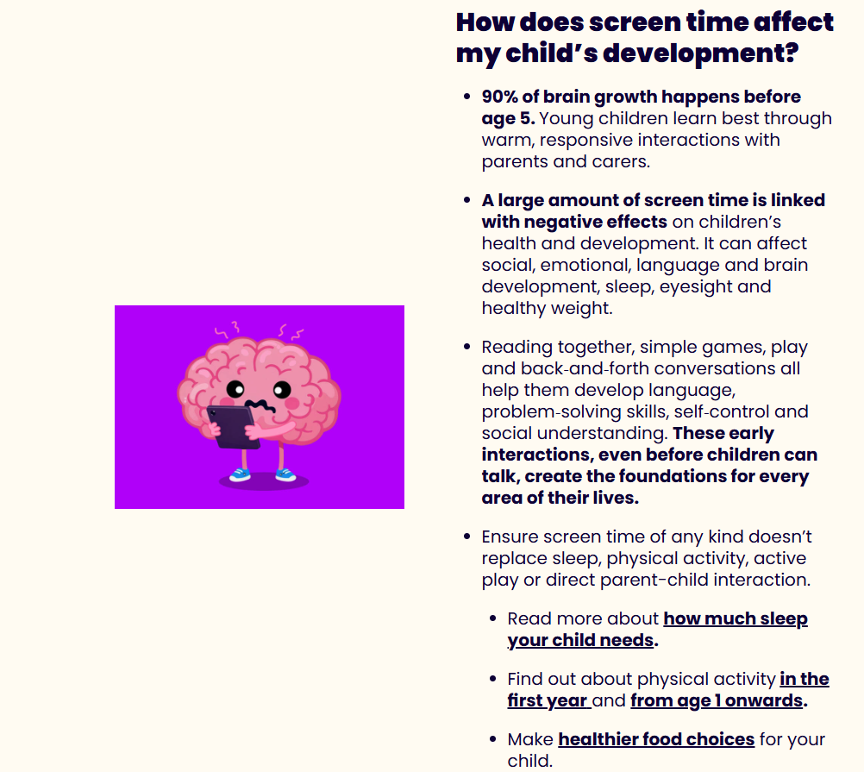
Screen Time and Online Safety
https://beststartinlife.gov.uk/screen-time-under-5s/
Government Guidance on Screen Time
2-5 year olds- less than an hour a day
Under 2’s none

Slide 19
BOSS- Buckden Out of School Care
Booking into BOSS can happen once your child is registered on Arbor as this links to the BOSS booking and payment system which is accessed via the school website. You will receive this access within the next fortnight from the school office.
Places for before and after school for your child may be booked for Monday 14th September onwards.
Bookings cannot be adhoc, have to be regular for the year to aid staffing.
Current prices are £5 per hour, £5.50 for 7.30-8:30am session including breakfast. Opening times are 7:30am- 8:35am and from 3:15- 6pm with earlier 5:15pm close on Friday’s.
Email address BOSS@bpa.act-academytrust.org. Manager is Chloe Burling.

