Slide 1
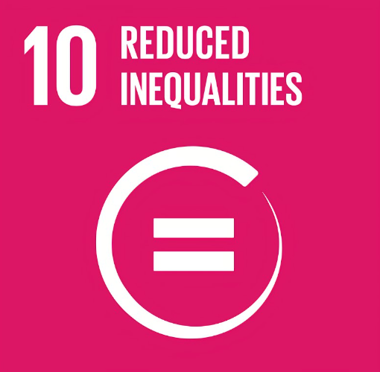



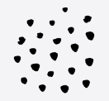
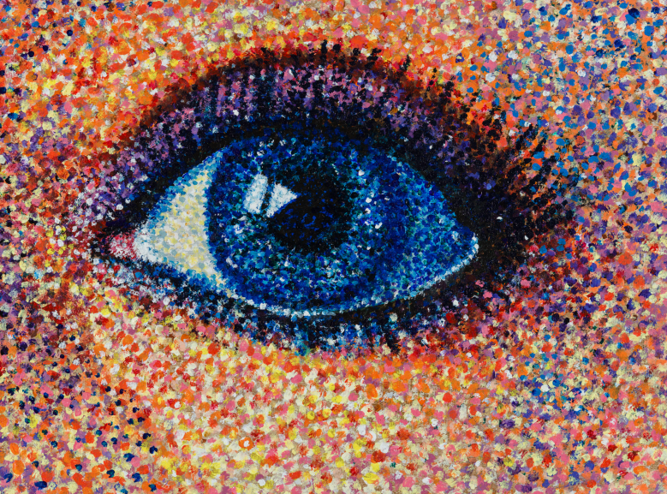


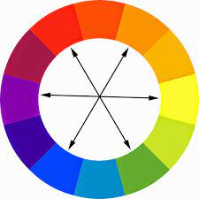


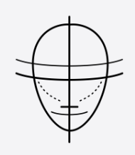


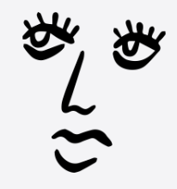

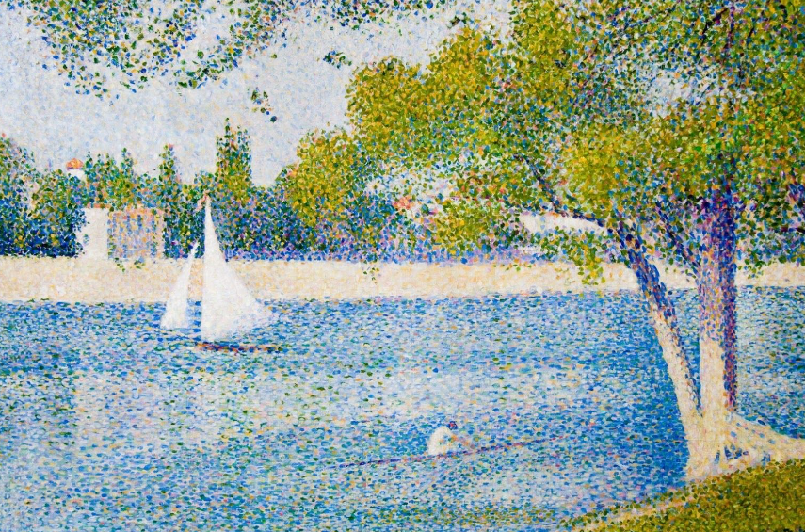



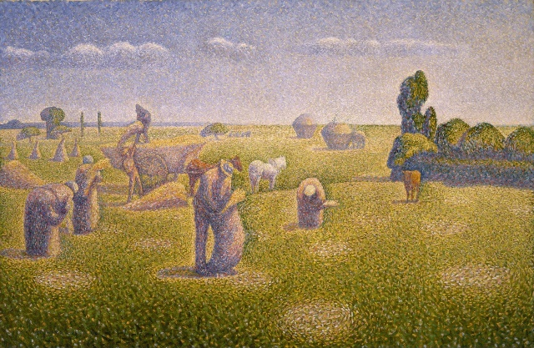
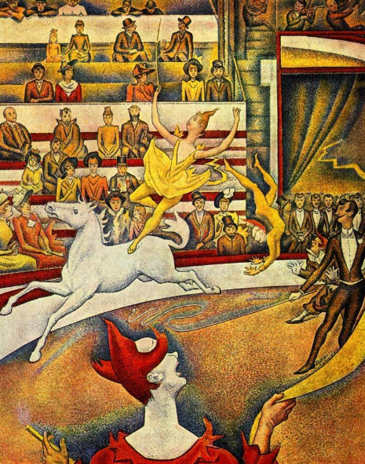
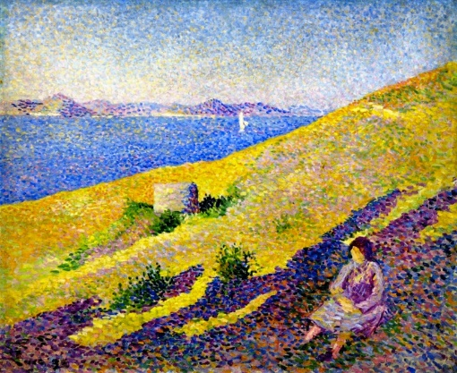
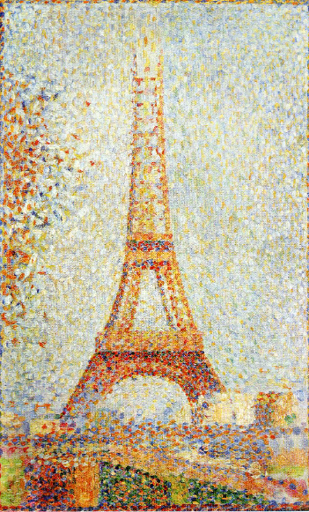
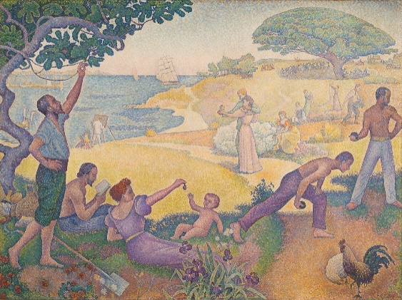



Art Knowledge Organiser
How does inequality affect someone’s life?
Year 4
Term Spring_2
Pointillism
A technique of painting in which small, distinct dots of pure colour are applied in patterns to form an image.
Art movements and Impressionism
An art movement is when a group of artists use a similar style or technique, material or paint.
Impressionism: A movement known to have began in Paris in the 1860’s. Artists often enjoyed painting in the open air in front of their subjects ‘en plein air’. Quick brush strokes with thick dabs of paint. Creating an impression of a photo, an idea or version.
Colour blending
Instead of the paint being blended and mixed on a palette, the paint is directly applied to the canvas. The fact that the dots are so close together cause the colours to appear blended.
How to sketch a face
Start by drawing an oval shape.
Using a ruler, faintly draw a vertical and horizontal centre line.
Underneath the horizontal centre line, draw another line between this and the bottom of the oval.
Measure halfway between the last line just drawn and create another line across.
Draw on some eyes on the horizontal centre line.
Draw a nose on the line underneath the eyes.
Draw a mouth on the line underneath the nose.
Add some eyebrows, ears, and hair.
Artist
Georges Seurat
Pointillism techniques
To create pointillism, the end of a pencil, an earbud or the end of a paintbrush, the brush end should not be used to create the pointillism effect.
Vocabulary Tier 2
Experiment
Tools
Techniques
Colour
Dots
Vocabulary Tier 3
Pointillism
Blending
Impressionism
Sketch
Vertical
Horizontal

