Slide 1














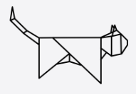




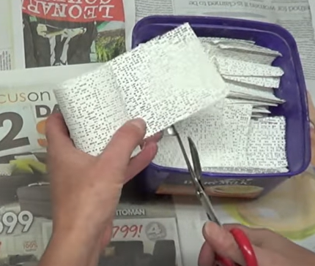
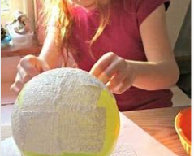
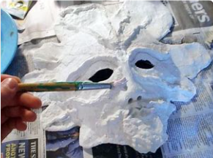



Design & Technology
Knowledge Organiser How does inequality affect someone’s life?
Year 4
Term Spring_2
Modroc
Modroc is a name for an art technique using bandages with plaster on them which can be used to make sculptures when water is added.
Modroc comes from the meaning “mod” meaning mud
And “roc” meaning rock when the Modroc dry's and hardens.
Materials
Sculptures can be made out of different materials to form your frame, such as wire, plastic, stones, paper, cartons or balloons.
Design stage
Before making the final piece of Modroc art, a sketched example of what the real thing will look like should be generated, to develop and improve the final design of your piece of art. This will allow for adaptations to be made before the final piece of art is ambled.
Making techniques
Modroc can create a variety of different structures using a different frame. Once chosen the same steps apply to build up your piece of art;
Collect all your materials, a roll of Modroc, scissors, water in a wide open container, and your final design of what you want your art to look like.
Cut the Modroc into sized pieced or strips that are easy to layer and manipulate.
Once your frame for the Modroc is ready, wet a piece of Modroc and place it on your frame. Repeat the process until all your frame is covered.
Shape and depth can be built by adding further layers and shapes onto your Modroc sculpture.
Evaluation and improvements
Checking that the product made meets the design criteria and has achieved its purpose. Reflections on your art can consider what worked well, what could have been done differently and what could have improved your art.
Vocabulary Tier 2
Materials
Structure
Decorate
Join
Shape
Pattern
Vocabulary Tier 3
Modroc
Adapt
Anglo Saxon
Sculpture
Sketch

