Slide 1

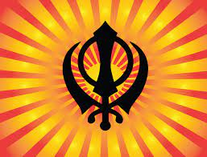
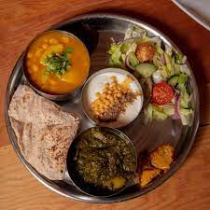
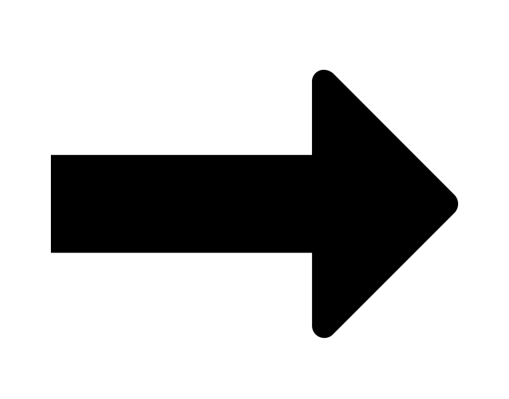
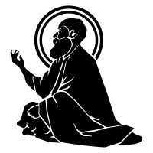
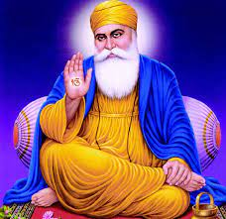
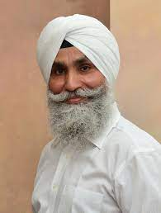
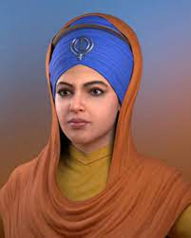

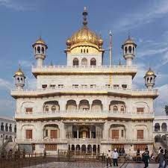

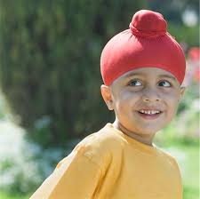



Year 4
Knowledge Organiser
Sikhism: How do Sikhs put their beliefs about equality into practice?
Term Spring 1
Sikhs believe everyone is equal.
Langar: The free kitchen at the Gurdwara where all can eat. All are expected to help serve here.
Guru Nanak taught that God was present in everyone.
Singh: Means ‘lion’ a name for all Sikh boys.
Kaur: Means ‘princess’ a name for all Sikh girls.
A Gurdwara is a place of assembly and worship for Sikhs.
A Patka is a head covering which is worn by many Sikh children in preference to its ‘bigger brother’ the turban.
Vocabulary Tier 2
Sikh
Sikhism
Belief
Equal
equality
Vocabulary Tier 3
Gurdwara
Singh
Kaur
Guru Nanak
Patka
Langar

