Slide 1
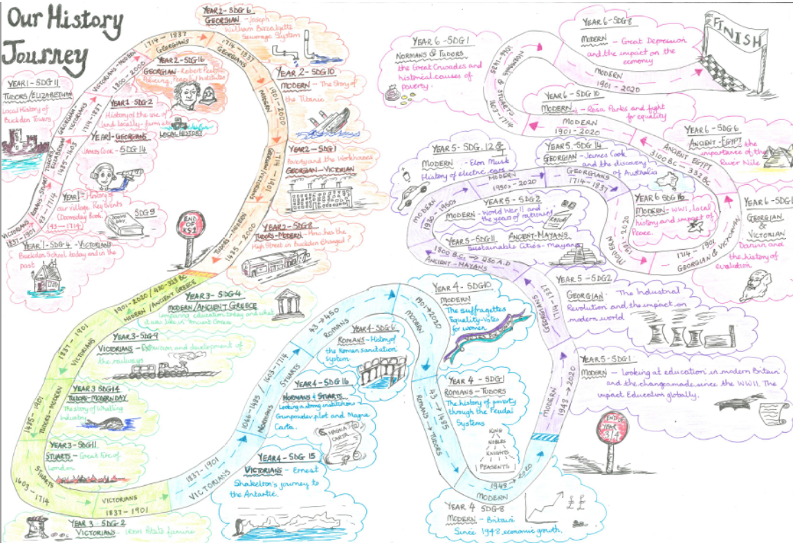


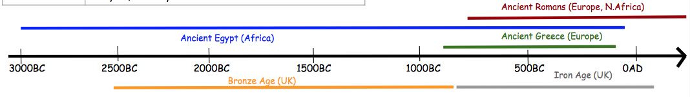

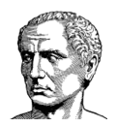
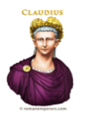


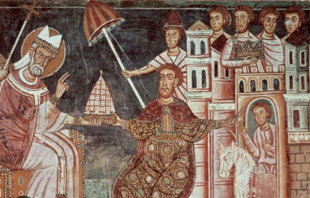
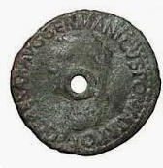
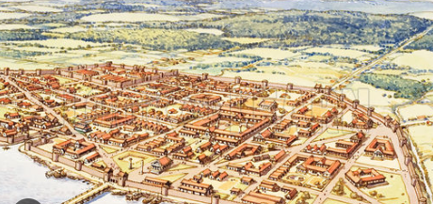
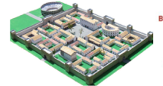
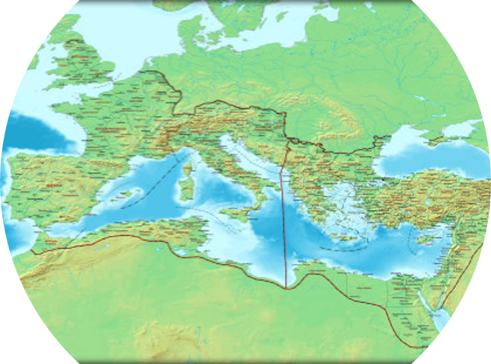
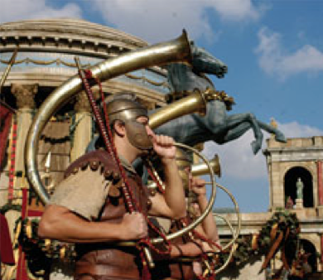

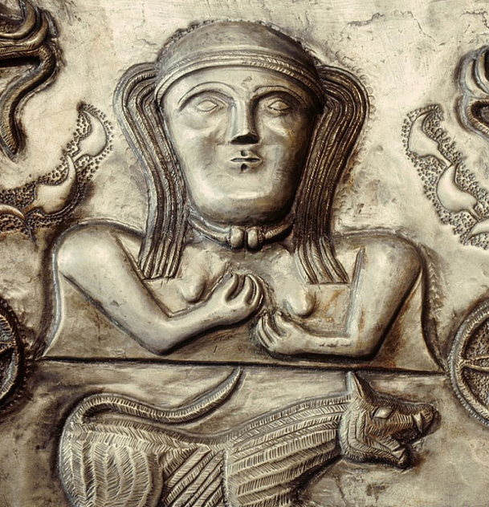



Year 4
History Knowledge Organiser
How did the Roman influence Britian with their innovations.
Term Spring 1
Roman Empire
Before the Romans invaded, there was no singular king or queen of Britian. People in Britian were called the Celts and there were many tribes.
735BC Rome was founded by Romulus | 55-54 BC Julius Caesar attempts to invade Britain | 43AD Emperor Claudius successfully invades Britain and it is part of the Roman Empire. | 50AD Londinium (London) was founded. | 60 – 61AD Boudia leads the Iceni in revolt against the Romans | 122-128 AD Hadrian's wall was built on the Scottish Border | 150AD Around 20 Roman towns established with full set of buildings | 313 AD Constantine legalised Christianity | 410AD Romans left but some Roman villas still occupied.
Roman Empire
The Ancient Romans built an empire that had Rome in the centre and stretched from Scotland to Syria.
It lasted from 700BC to 476AD
It had a powerful army.
The Roman Empire there were slaves and citizens.
It became rich by trading across the world.
Invasion
Romans came to Britannina because there was lots of natural resources: lead, wood, tin, wool, slaves, gold, silver and corn.
They also wanted to be seen as a powerful empire.
The emperors were ambitious.
Native Britons – Celts.
Some Celts in Britain did not want to be invaded and made into slaves.
Some Celts did trade and cooperation with the Romans.
Romans impact on Britain – aqueducts, sanitation, currency, roads, calendar, language, towns, foods, entertainment.
Roman influence today – language, numerals, cement, art, and laws
Vocabulary Tier 2
conquest
revolt
barbarian
evidence
empire
Vocabulary Tier 3
emperor
legionary
Celts
aqueduct
Latin

