Slide 1
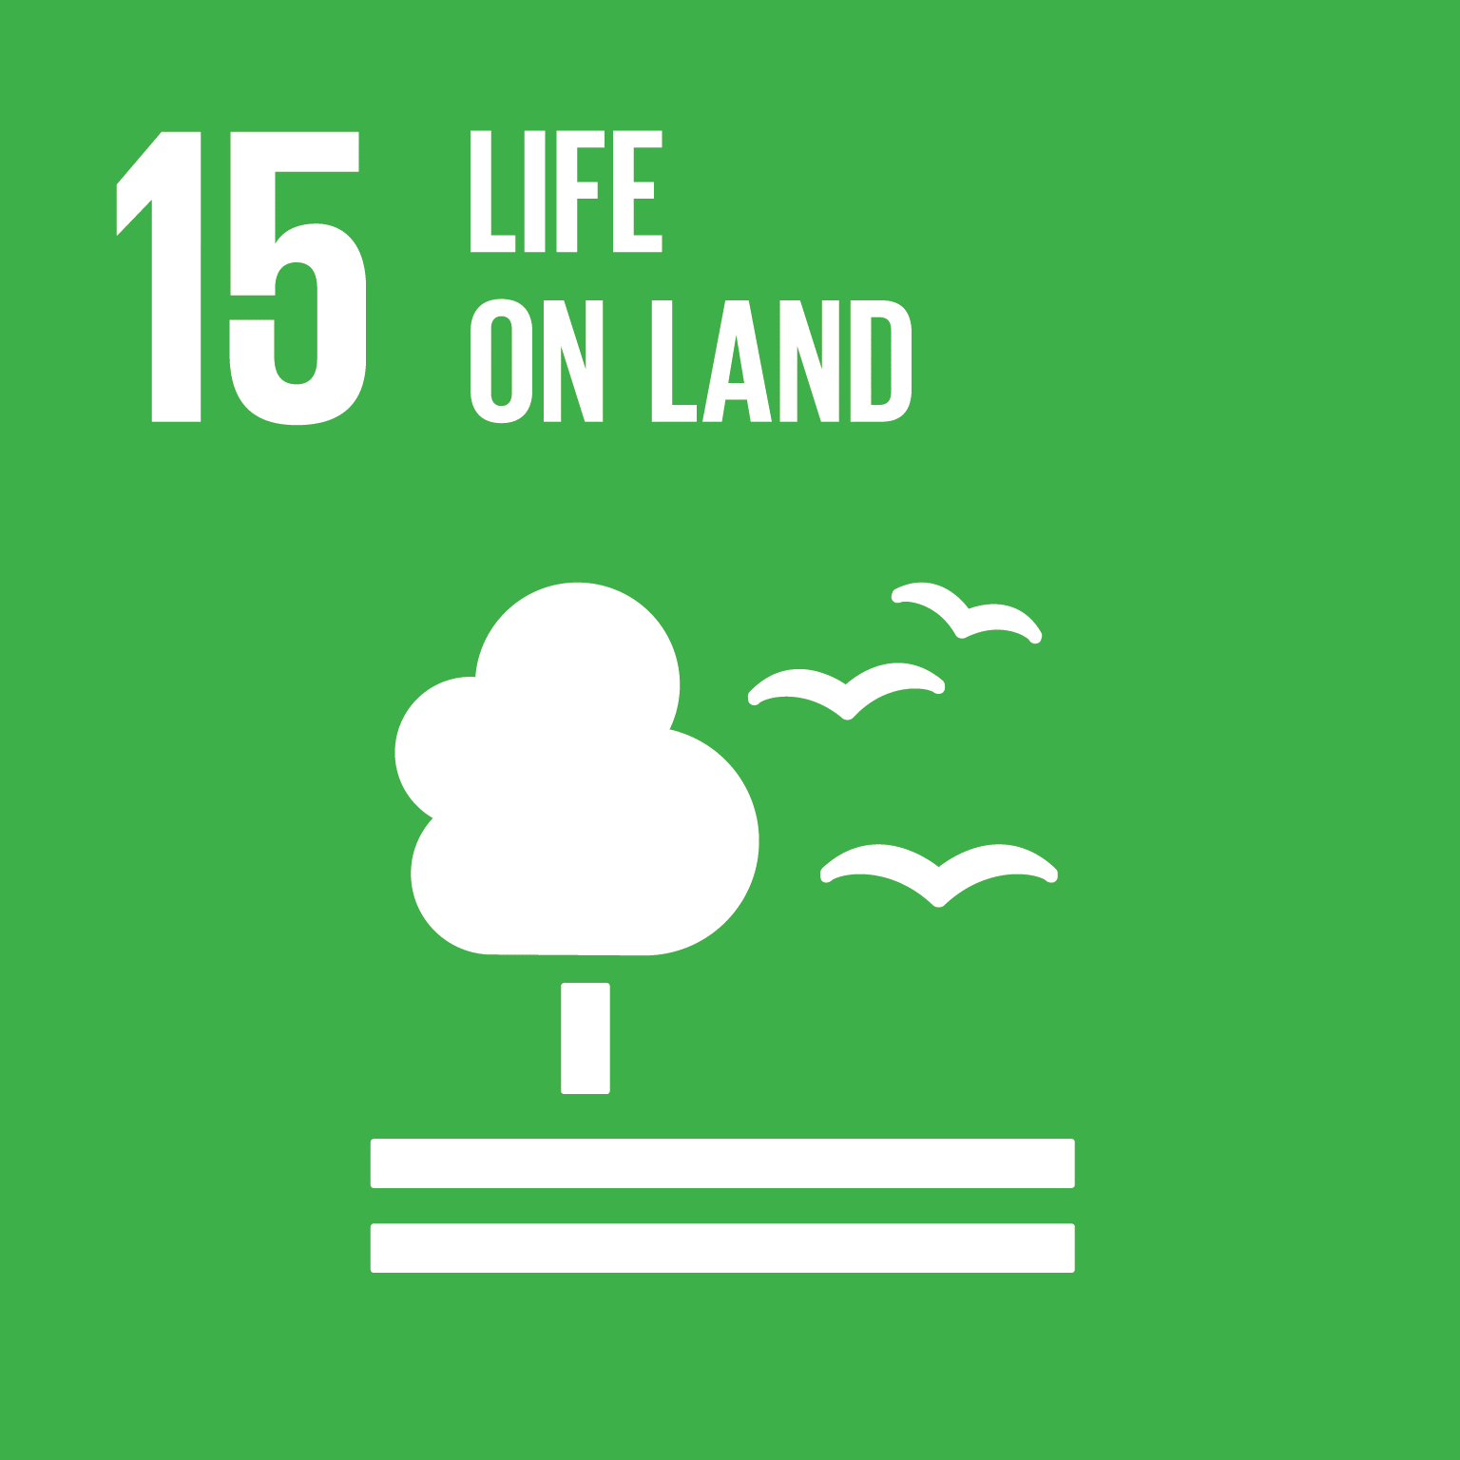



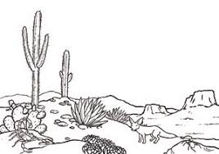
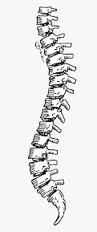
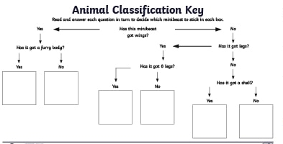
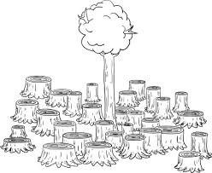



Year 4
Living things and their habitats
Science
Term Autumn_1
What do we know:
- How to identify and name a variety of plants and animals in their habitats.
What are we going to learn:
To recognise that living things can be grouped in a variety of ways
Explore and use classification keys to help group, identify and name a variety of living things in their local and wider environment.
Recognise that environments can change and that this can sometimes pose dangers to living things.
Living things:
Living things are alive. They need food, water and air to live. They reproduce, grow and change, and respond to changes in the environment.
Plants
Animals
Vertebrates
Invertebrates
Mammals
Reptile
Fish
Birds
Amphibians
Insects
Spiders
Worms
Slugs and snails
Key vocabulary
Classification: The process of grouping organisms together based on their similarities.
Vertebrates: Animals with a backbone.
Invertebrates: Animals without a backbone.
Specimen: A particular plant or animal that scientist's study to find out about its species.
Habitat: The natural home or environment of an animal, plant or other organism.
Environment: An environment contains many habitat's and these include areas where there are both living and non-living things.
Classification key: Classification keys that are divided into two parts, using ‘yes’ and ‘no’ questions.
Life processes: To stay alive and healthy, all living things need certain conditions that let them carry out the seven life processes:
Life processes:
Movement Respiration Sensitivity
Growth Reproduction Excretion Nutrition

